Slide 1
Expressing Yourself
Basic 5 – Unit 2 a - Feelings

Slide 2
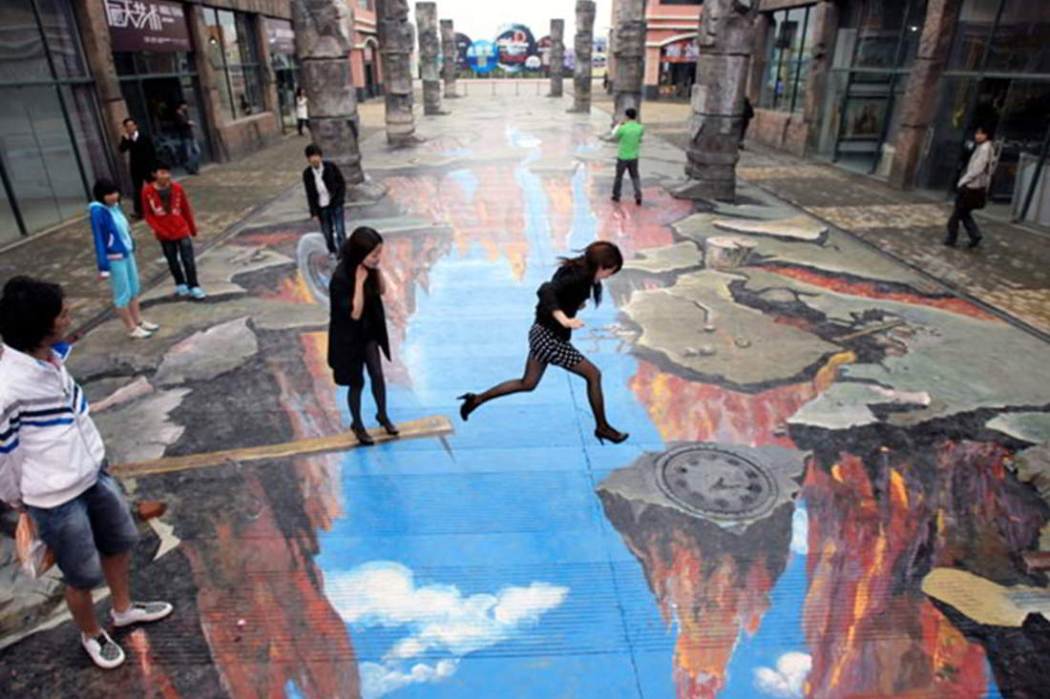

Slide 3
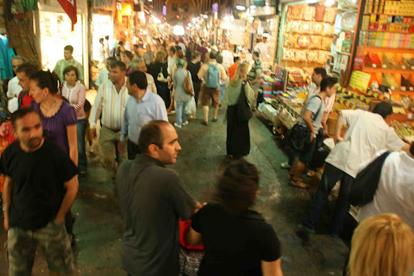

Slide 4
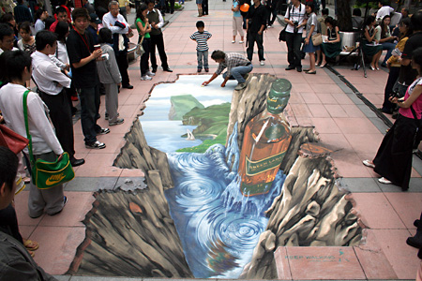

Slide 5
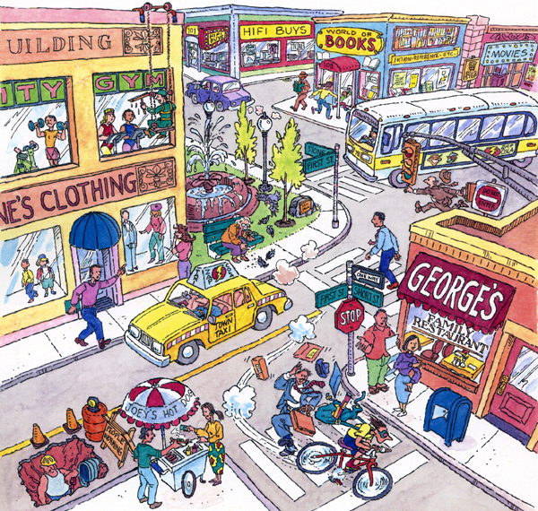

Slide 6
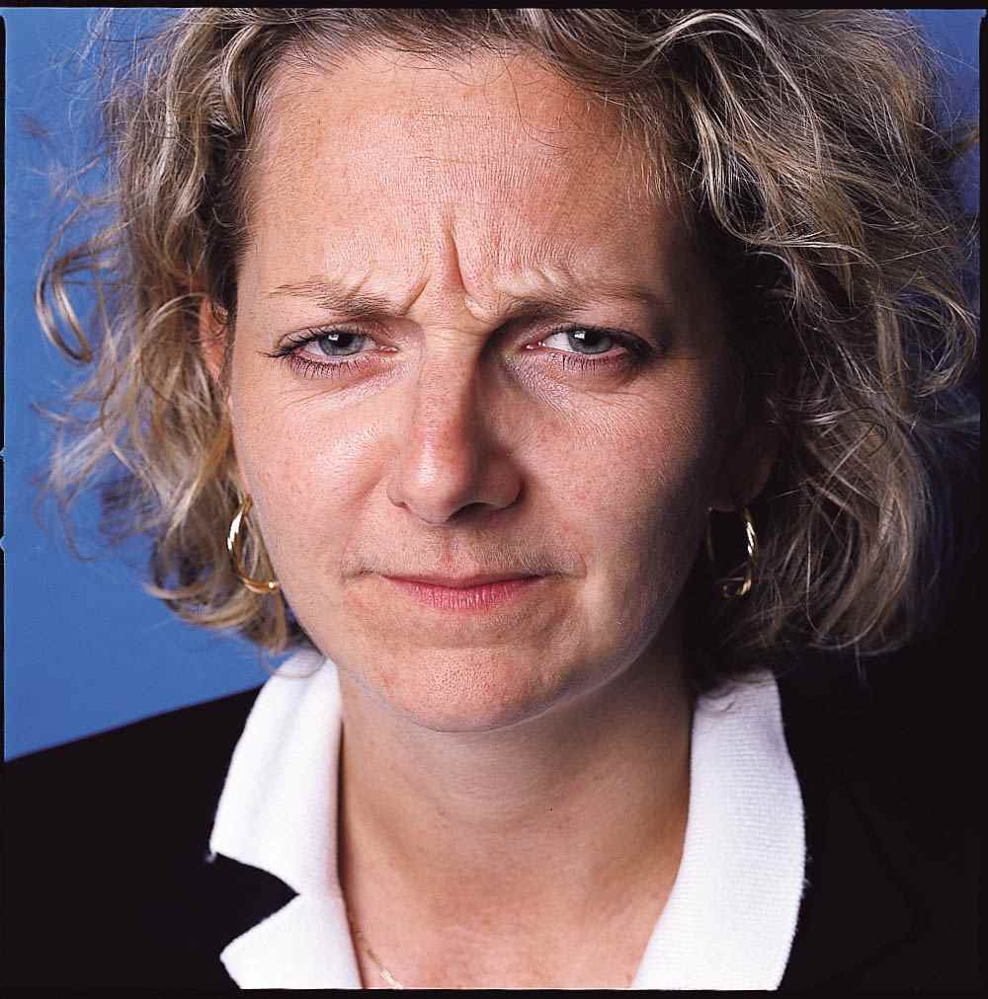

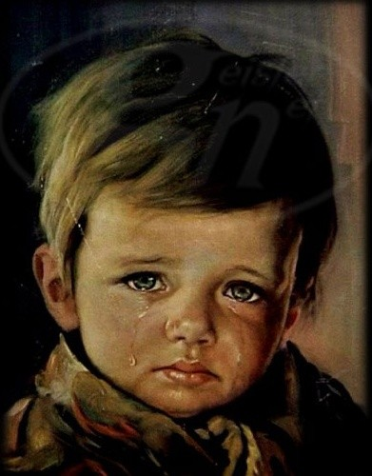
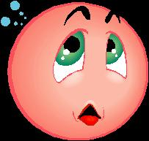
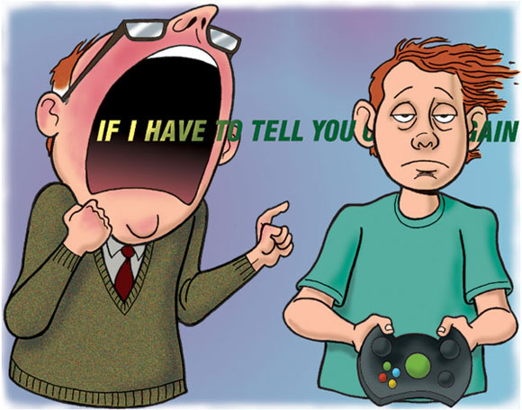
What are they doing?
FROWNING
SMILING
YELLING /SHOUTING
CRYING
BLUSHING

Slide 7
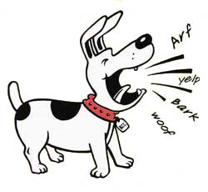
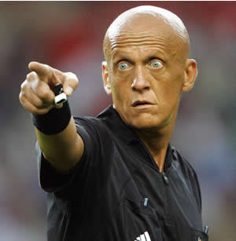
What is it doing?
What is he doing?
It´s barking at someone
He is pointing (at a person)

Slide 9
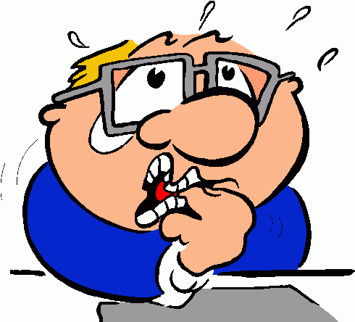

How are they doing?
FRUSTRATED
NERVOUS

Slide 10
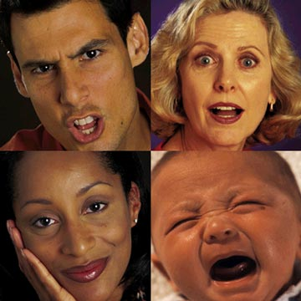
How are they doing? He / she is…
ANGRY
SURPRISED
HAPPY and RELAXED
SAD

Slide 11
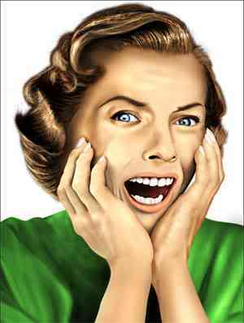
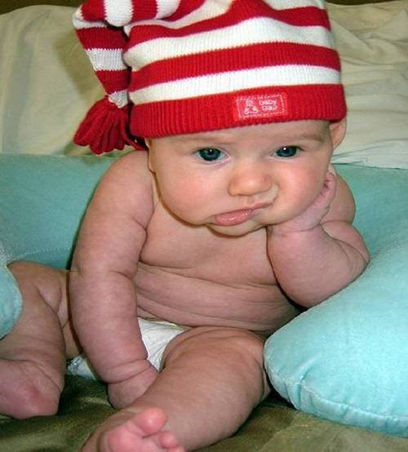
How are they doing?
FRUSTRATED
SCARED
BORED
EMBARRASSED
NERVOUS

